Slide 1
Designing Software Architecture -Introduction
Eunseok Lee, Prof.
College of Software
Sungkyunkwan University

Slide 2
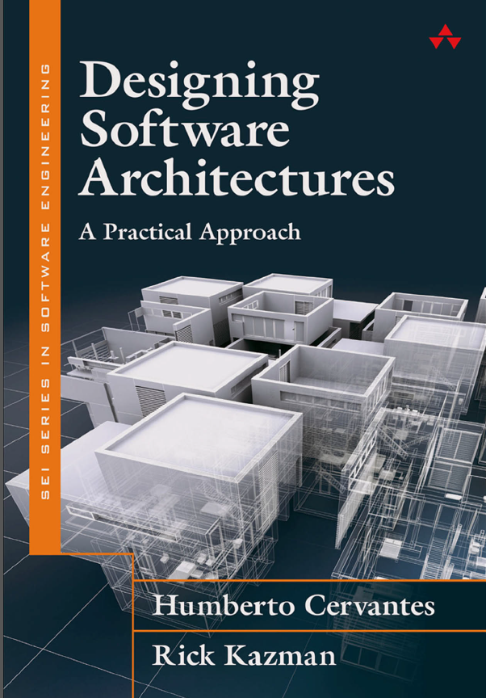
About the book
Humberto Cervantes & Rick Kazman
SEI Series in software Engineering
Carnegie Mellon University
Addison-Wesley 2016

Slide 3
Objectives
Provide an introduction to the topic of software architecture;
Discuss what architecture is and why it is fundamental to take it into account when developing software systems;
Discuss the different activities that are associated with the development of software architecture;
Discuss the role of the architect;
Introduce the Attribute-Driven Design (ADD) method.

Slide 4
Topics covered
Software architecture
Importance of software architecture
Software architecture design processes
Software architect
ADD(Attribute-Driven-Design)

Slide 5
1. Motivation
Goal is to teach you how to design software architecture in a systematic, predictable, repeatable, and cost-effective way.
In most fields, “design” involves the same sorts of challenges and considerations:
meeting stakeholder needs,
adhering to budgets and schedules,
dealing with constraints, and so forth
Notes:
If you are reading this book, then presumably you already have an interest in architecture and aspire to be an architect.
Design is not the sole province of wizards

Slide 6
2. Software Architecture
“The software architecture of a system is the set of structures needed to reason about the system, which comprise software elements, relations among them, and properties of both.”
<Software Architecture in Practice, 3rd edition, 2012>
“The fundamental organization of a system embodied in its components, their relationships to each other, and to the environment, and the principles guiding its design and evolution.”
<IEEE Std. 1471, 2000>
“The architecture is Fundamental concepts or properties of a system in its environment embodied in its elements, relationships, and in the principles of its design and evolution.”
<ISO/IEC/IEEE 42010, 2011>
Notes:
- Much has been written on what software architecture is. We adopt the definition of software architecture from Software Architecture in Practice (third edition):

Slide 7
2. Software Architecture
2.1 The Importance of Software Architecture
Inhibit or enable a system’s driving quality attributes.
The decisions made in an architecture allow you to reason about and manage change as the system evolves.
The analysis of an architecture enables early prediction of a system’s qualities.
A documented architecture enhances communication among stakeholders.
The architecture influences the structure of an organization, and vice versa.
An architecture can provide the basis for evolutionary, or even throwaway, prototyping.
Notes:
- Much has been written on what software architecture is. We adopt the definition of software architecture from Software Architecture in Practice (third edition):

Slide 8
2. Software Architecture
2.1 The Importance of Software Architecture(cont’)
An architecture is the key artifact that allows the architect and the project manager to reason about cost and schedule.
An architecture can be created as a transferable, reusable model that forms the heart of a product line.
Architecture-based development focuses attention on the assembly of components, rather than simply on their creation.
By restricting design alternatives, architecture channels the creativity of developers, reducing design and system complexity.
An architecture can be the foundation for training a new team member.
Notes:
- If an architecture is important for all of these reasons—if it affects the structure of the organization, and the qualities of the system, and the people involved
in its creation and evolution—then surely great care must be taken in designing this crucial artifact.
Sadly, that is most often not the case.
Architectures often “evolve” or “emerge”.
While we have nothing against evolution or emergence, and while we emphatically are not arguing for “big design up front”, doing no architecture at all is often too risky for anything but the simplest projects.
Would you want to drive over a bridge or ride in a jet that had not been carefully designed?
Of course not.
But you use software every day that is buggy, costly, insecure, unreliable, fault prone, and slow—and many of these undesirable characteristics can be avoided!
The core message of this book is that architecture design does not need to be difficult or scary; it is not the sole province of wizards; and it does not have to be costly and all done up front.
Our job is to show you how and convince you that it is within your reach.

Slide 9
2. Software Architecture
2.2 SA Life Cycle Activities
Architectural requirements
ASR(Architecturally Significant Req.)
Very important functionalities, constraints, and QAs
ex) high performance, high availability, ease of evolution, high security, etc
Guide you to choose one set of architectural structures and components over another.
Architecture design drivers
Notes:
Software architecture design is one of the software architecture life-cycle activities (Figure 1.1).
As in any software project life cycle, this activity is concerned with the translation of requirements into a design into an implementation.
Specifically, the architect needs to worry about the following issues:
(1)AR
Among all the requirements, a few will have a particular importance with respect to the software architecture. We call it, ASRs
We will refer to these ASRs and concerns as drivers, as they can be said to drive the design. (결정자, 구동자)

Slide 10
2. Software Architecture
2.2 SA Life Cycle Activities
(2) Architectural design
Design is a translation, from the needs (requirements) to the solutions, in terms of structures
Composed of code, frameworks, and components.
A good design is one that satisfies the drivers.

Slide 11
2. Software Architecture
2.2 SA Life Cycle Activities
(3) Architectural documentation
Refers to the creation of a more formal document from rough sketches.
When the project is large, distributed teams are collaborating, or significant technical challenges exist.
While documentation is often avoided and derided by programmers, it is a standard, non-negotiable deliverable in almost every other engineering discipline.
Notes:
Some level of preliminary documentation (or sketches) of the structures should be created as part of architectural design.
If the project is small and has a precedent, then architecture documentation may be minimal.
In other engineering disciplines, a “blueprint”—some sort of documented design—is an absolutely essential step in moving toward implementation and the commitment of resources(자원투입).

Slide 12
2. Software Architecture
2.2 SA Life Cycle Activities
(4) Architectural evaluation
Ensure that the decisions made are appropriate to address the critical requirements
Similar with delivering code after testing
Typically evaluation is done informally and internally, but for truly important projects advisable formal evaluation by an external team.
Notes:
- As with documentation, if your project is nontrivial, then you owe it to yourself and to your stakeholders to evaluate it—that is, to ensure that…

Slide 13
2. Software Architecture
2.2 SA Life Cycle Activities
(5) Architectural implementation/conformance checking
Need to tweak the design as the system grows and as requirements evolve.
Major responsibility during implementation is to ensure conformance of the code to the design.
Without conformance checking, we have no way of ensuring the quality of what is being subsequently constructed.
None of these architecture activities is incompatible with Agile practices.
“Should I do Agile or architecture?” (X)
“How much architecture should I do up front versus how much should I defer until the project’s requirements have solidified somewhat?”
Notes:
Finally, you need to implement the architecture that you have created (and evaluated).
As an architect, you need to..
In addition to this tweaking(변경, 수정), major res….
If developers are not faithfully implementing the architecture, they may be undermining the qualities that you have designed in.
Today most commercial software is developed using some form of Agile methodology.
Agile and architecture are happy companions for many software projects.
We will discuss the relationship between architecture design and various software life-cycle methods and process models, including iterative development, in Chapter 9.
From

Slide 14
3. The Role of the Architect
An architect is much more than “just” a designer. Has a long list of duties, skills, and knowledge that must be satisfied if it is to be successful.
Leadership: mentoring, team-building, establishing a vision, coaching
Communication: both technical and nontechnical, encouraging collaboration
Negotiation: dealing with internal and external stakeholders and their conflicting needs and expectations
Technical skills: life-cycle skills, expertise with technologies, continuous learning, coding
Project skills: budgeting, personnel, schedule management, risk management
Analytical skills: architectural analysis, general analysis mindset for project management and measurement
Notes:
- These prerequisites include the following:

Slide 15
4. A Brief History of ADD
1st version of ADD: (ADD 1.0, originally called ABD, for “Architecture-Based Design”) January 2000,
2nd version: (ADD 2.0) was published in November 2006,
3rd version: (ADD 3.0) 2016 for agile development with quick design iteration.
ADD is the most comprehensive and most widely used documented architecture design method.
The first design method to focus specifically on quality attributes and their achievement
It includes architecture analysis and documentation as an integral part of the design process.
Notes:
While an architect has many duties and responsibilities the single most important skill that a software engineer must master to be called “architect”: the process of design.
To make architectural design more tractable and repeatable, in this book we focus most of our attention on the Attribute-Driven Design (ADD) method, which provides step-by-step guidance on how to iteratively perform the design activity shown in Figure 1.1.
Before ADD 3.0, ADD2.5(2013) was proposed to overcome the shortcomings of ADD 2.0, to apply it to real world and many different contexts.

Slide 16
Key points
Software architecture is a description of a set of major elements, communications between them, and control of them.
Software architecture has important roles for system analysis, construction and maintenance.
Architect has many duties and responsibilities, especially for architecture design.
ADD is one of prominent structured method for AD.

